Slide 1

A Full Stack Ecommerce Website
by Calvin Teater & Je’Shon Edwards

Slide 2
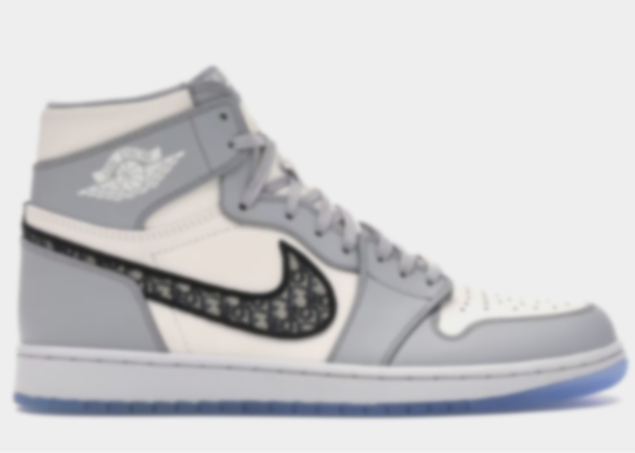
Why was Hype Heads created?
Our group members both have an interest in sneaker culture. For years both of us have been collecting high value sneakers and reselling some as well. With that comes the history of buying from retail and resell websites. That is when we came up with the idea of creating our own ecommerce website where you will have the ability to buy(auction)/sell/trade shoes and other apparel.
Based on our prior knowledge as a group we have the opportunity to push this website to the cloud and be visible and useful to the real world. With that, we also knew that this would be an opportunity to learn and use new frameworks and technologies.

Slide 3


Planning (Product Scope)
In-Scope:
GitHub: set up on systems, learn how to add and push(merge)
Next.js: go through tutorials and practice projects
Research new libraries and extensions:
Prettier - Code format
Tailwind CSS Intellisense
ES7 + React/Redux/React-Native snippets, and more
Out-of-Scope:
Pen Testing: work on security attacks
Microphone feature to search

Slide 4
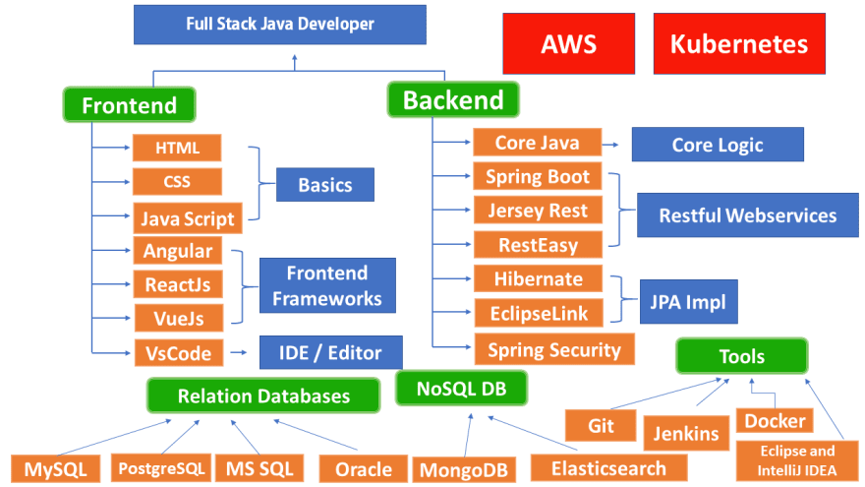
Software Engineer / Full Stack Development Roadmap

Slide 5
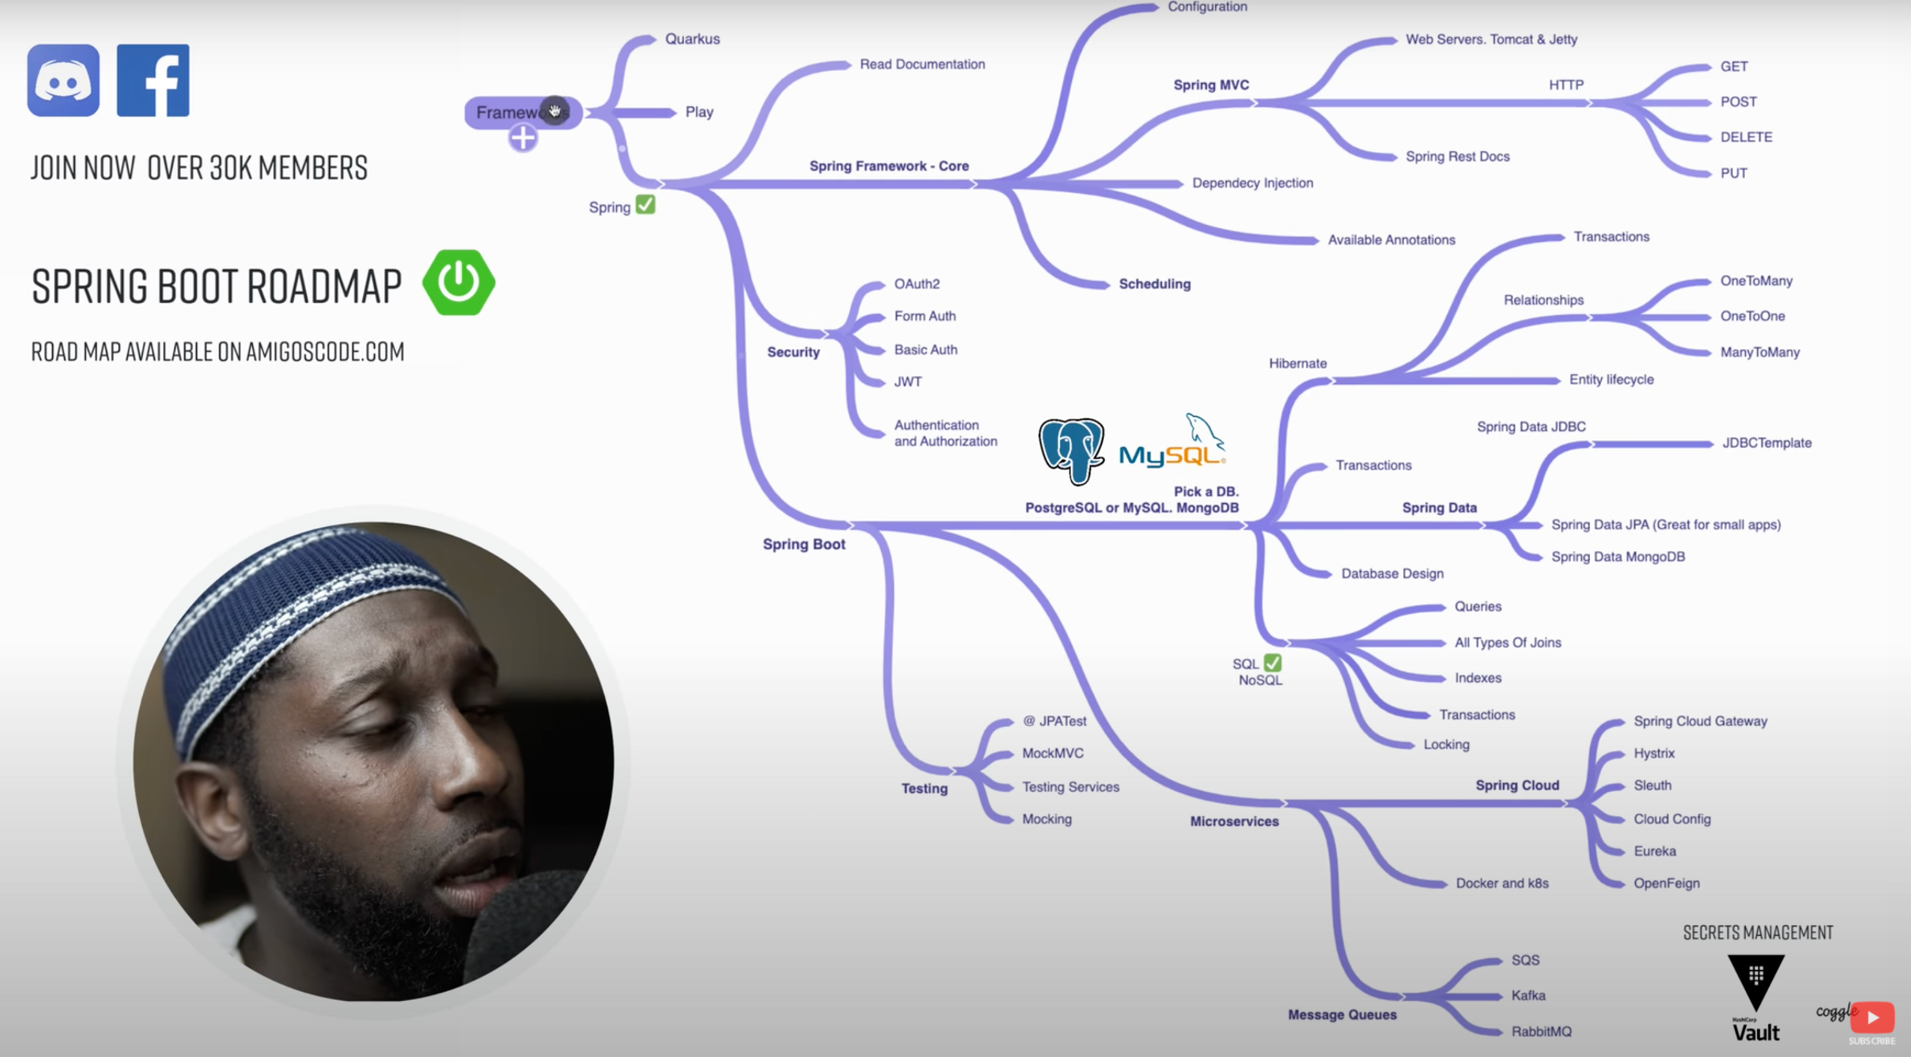
Spring Boot Roadmap

Slide 6

User Requirements
System should be a web application needs to be a functional online store
System needs to be able to connect to backend database that includes all products and registered accounts of buyer / sellers
System needs to be able be easily accessible so customers can view/buy/add products
System needs to be able to handle personal data (shipping information, card information, etc.) of buyers and give accessibility to manage accounts

Slide 7

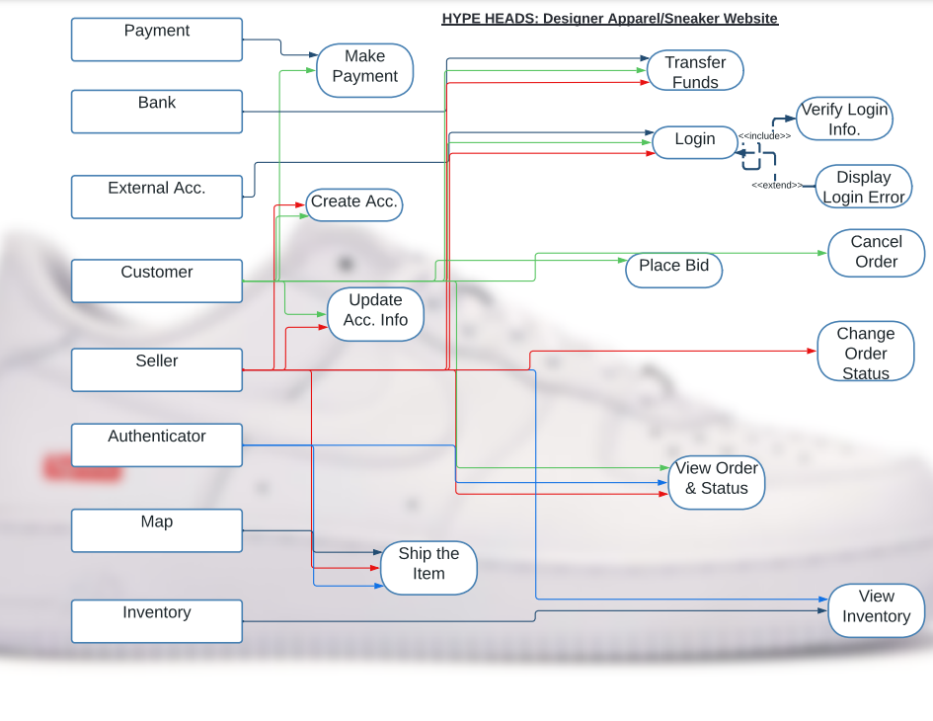
Use Case Diagram

Slide 8
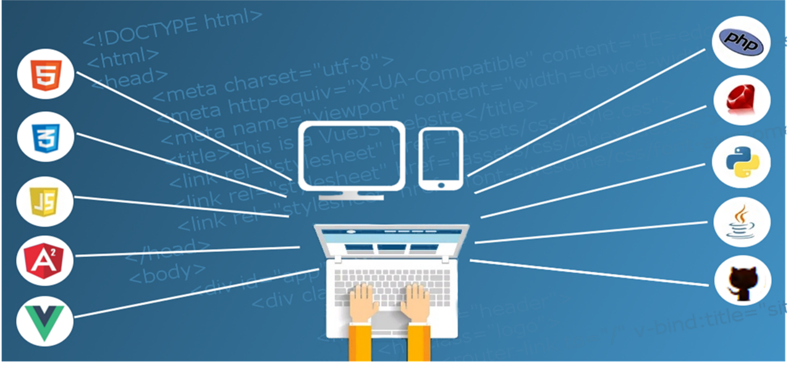
Design

Slide 9
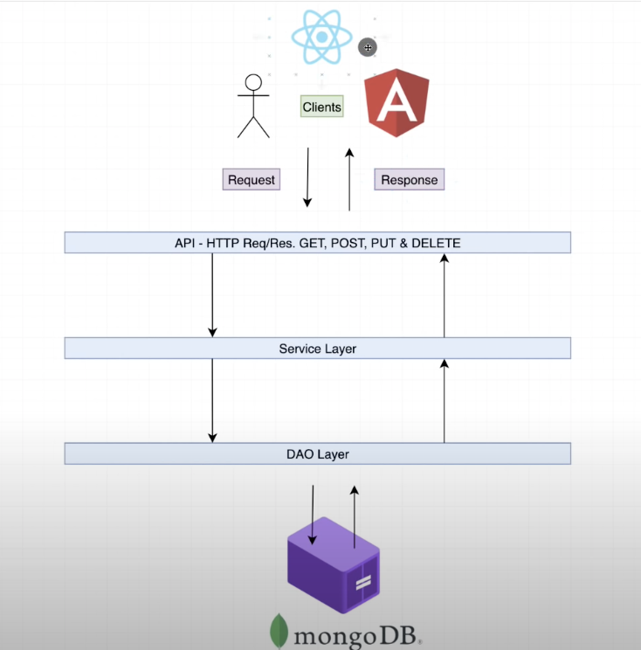
System Architecture
Client-Server & N-Tier

Slide 10
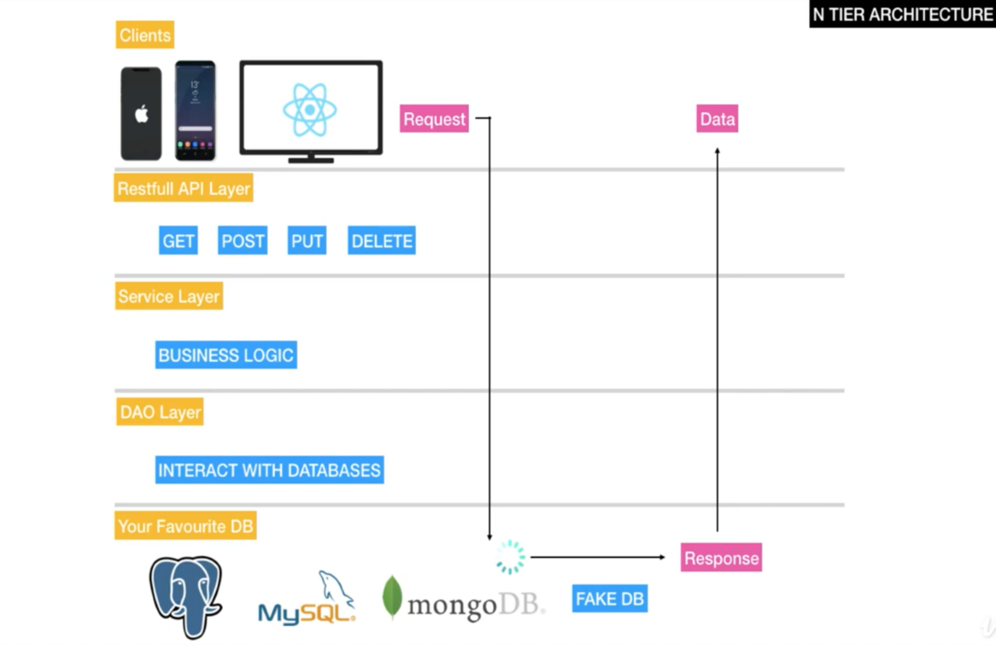

Slide 11
Tools Used
Design & Planning Tools: Figma, Project Manager
IDE: Visual Studio Code
Frontend: NextJs (React Framework) ~ Frontend UI
NPM ~ Frontend package manager
Libraries Installed:
TailWind CSS, Axios & Unfetch, Redux (State Management), Formik (form validation)
AntD, ChakraUI, HeroIcons, SlideShow, Swiper, Toastify, JavaScript Cookie
API’s: Open & Internal (public, private)
API Architecture: REST API
AJAX: Allows asynchronous interaction with webpages
Paypal Developer ~ used for sandbox account transactions
Backend:
Maven ~ build automation tool for java projects
Spring Boot & Spring Security ~ backend coding and security. Gives you a production ready application.
Database: MongoDB ~ created the database
Version Control: Git & GitHub ~ Shared “secrets” in there
API Tester: Postman
Virtualization/Containerization: Docker ~ created containers for MongoDB & Mongo Express

Slide 12

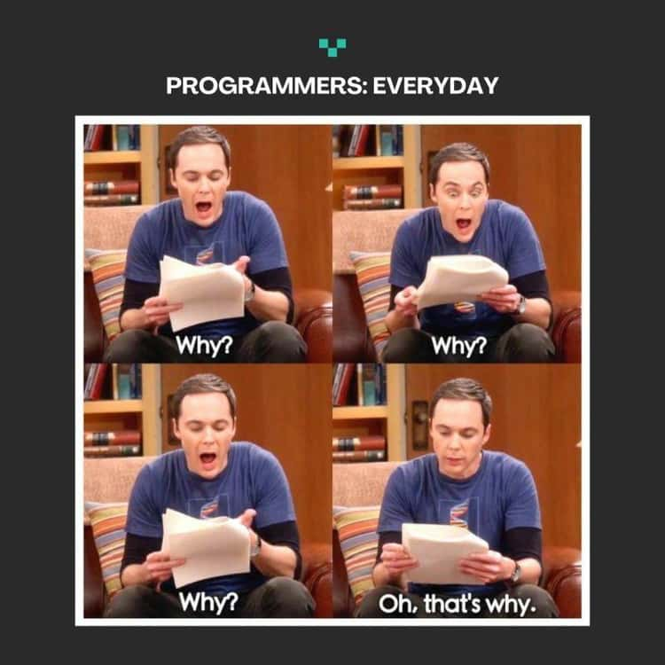
Implementation

Slide 13
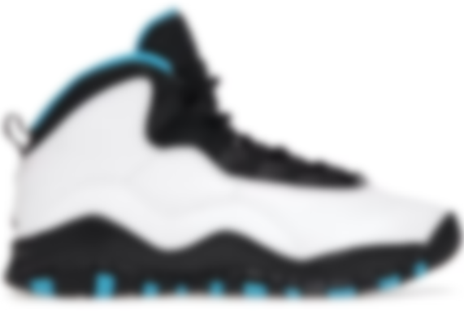
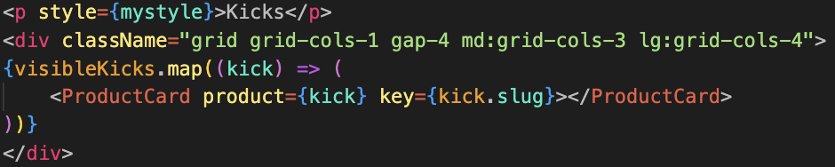
Rendering Products: Displays Products on Home Page

Slide 14

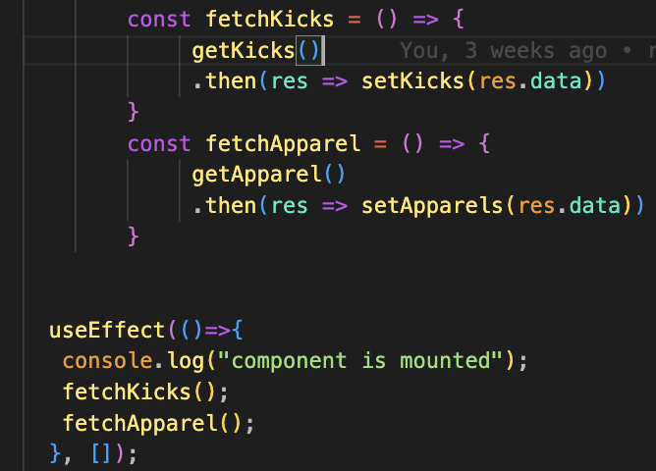
Rendering Products: Homepage calls Frontend API

Slide 15

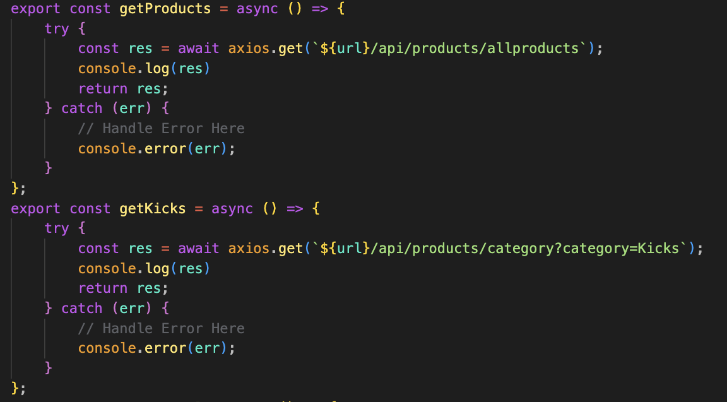
Rendering Products: Frontend API sends GET Request to Backend API

Slide 16

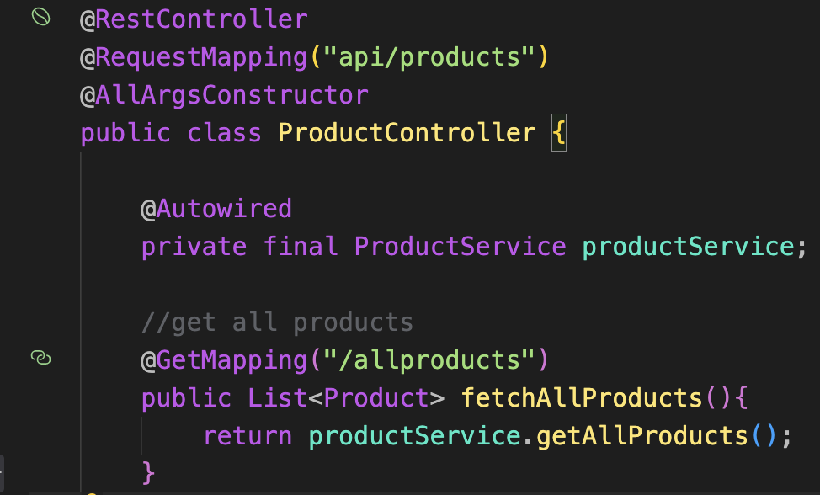
Rendering Products: Backend API Layer

Slide 17
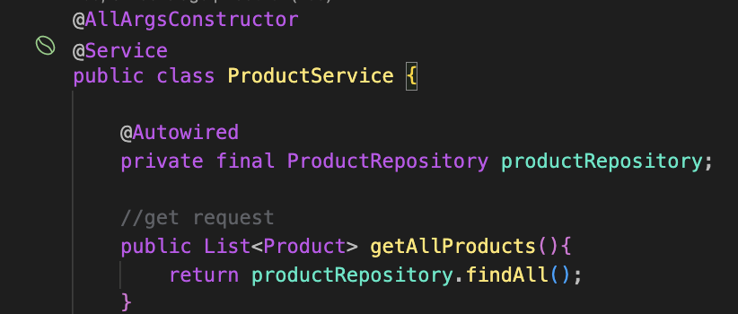
Rendering Products: Backend Service Layer (Business Logic)

Slide 18

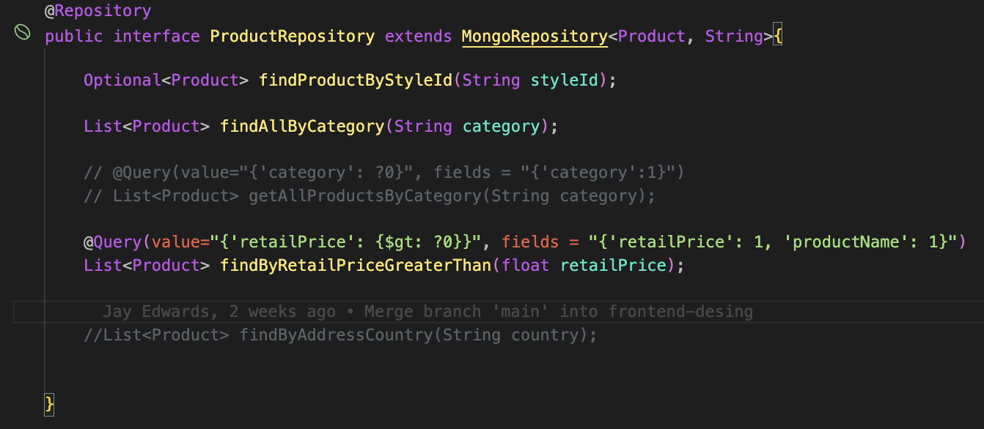
Rendering Products: Backend DAO Layer (DB communication)

Slide 19

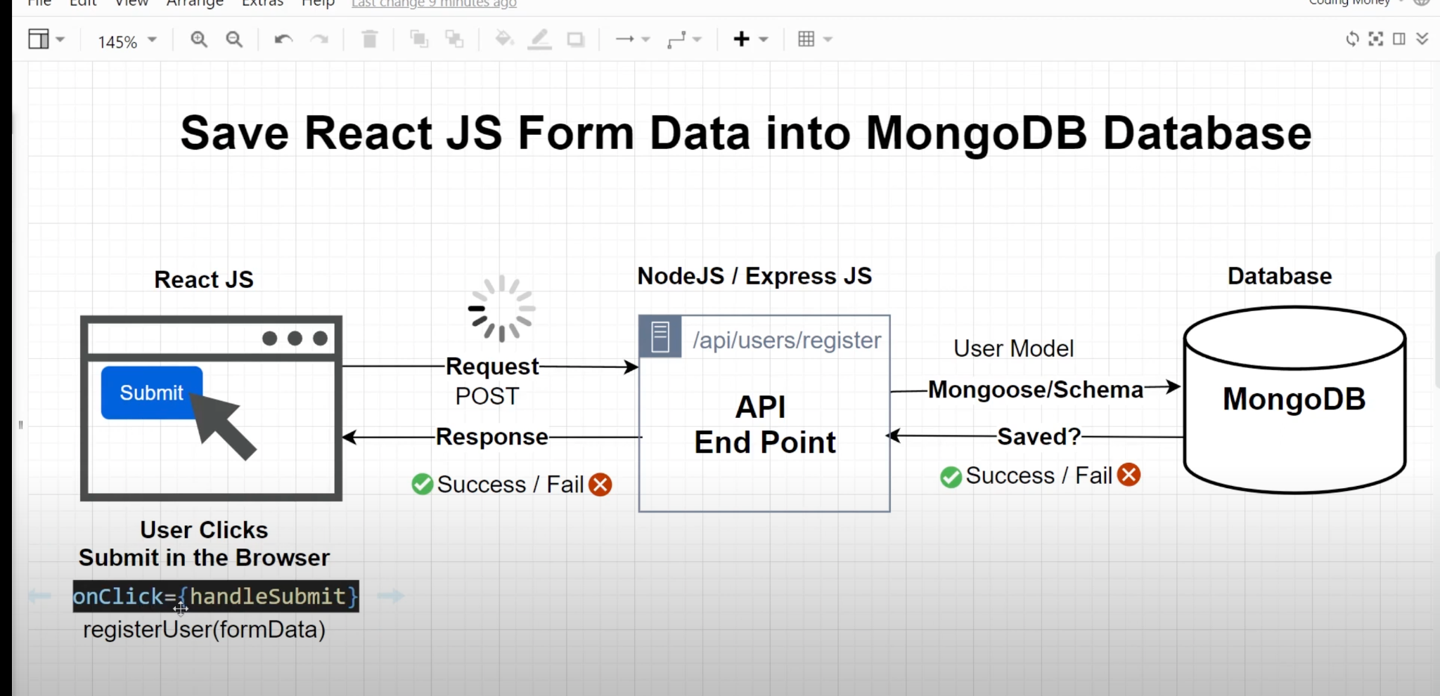
AJAX Request Visual
AJAX is like the postman who brings your mail envelope (REST) which contains the letter you want to read.

Slide 20

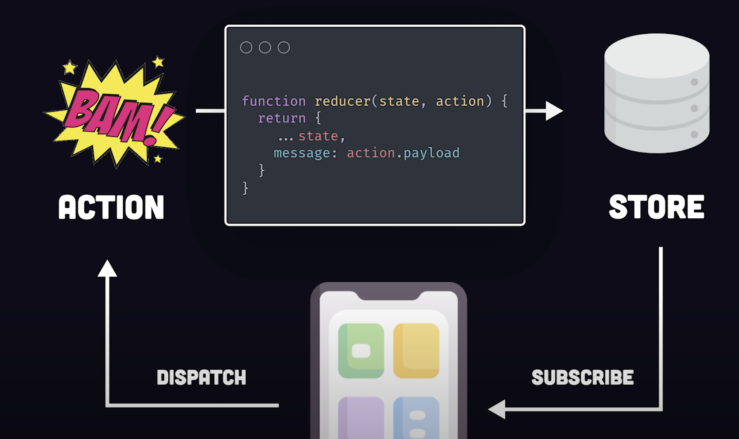
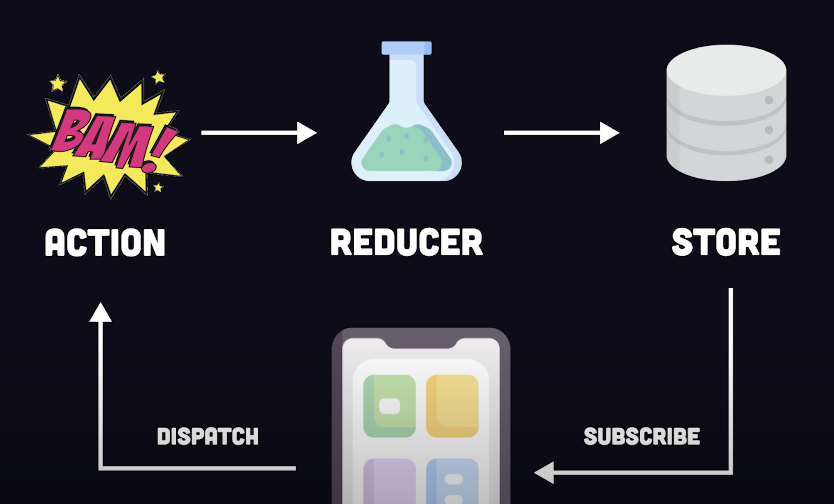
Redux State Management

Slide 21
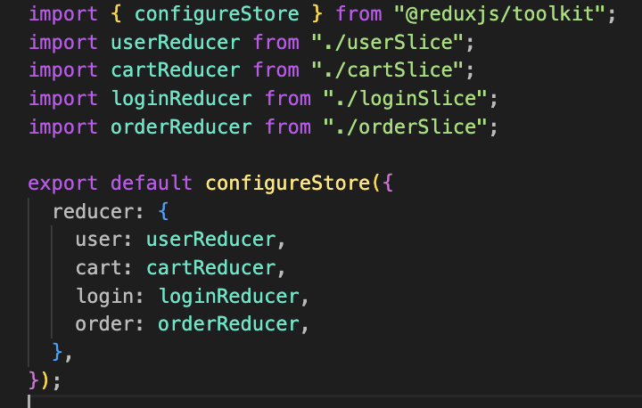
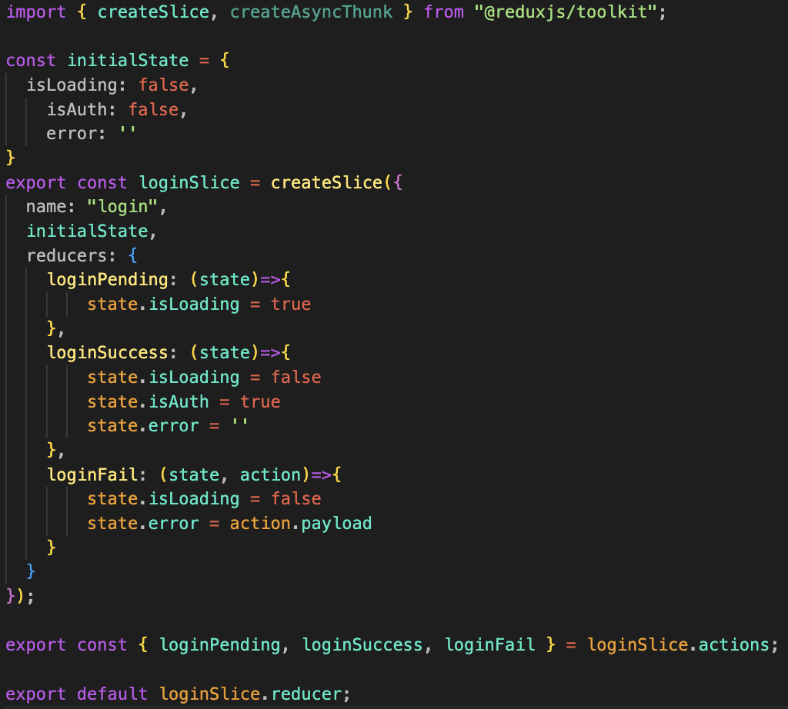
Redux State Management

Slide 22

Security Issues
●Login Protocols
●CORS
●Protection of credentials, endpoints, and requests

Slide 23
How did we combat these issues?
Utilized dependency injection throughout backend code:
The ability of an object to supply dependencies of another object.
Implemented Spring Security features:
A Spring Boot library that handles authentication and helps you set the right protections against potential threats.
Web Security Configuration file ~ configuration settings that impact global security
Rejected requests with a custom firewall (Deny-By-Default)
Set CORS configurations
Configured UserDetails Interface to retrieve a username, a password, and other attributes from the database for authentication.
JSON Web Token Authentication (JWT) ~ A way for two applications to communicate with each other and exchange information. Used for authorization.

Slide 24

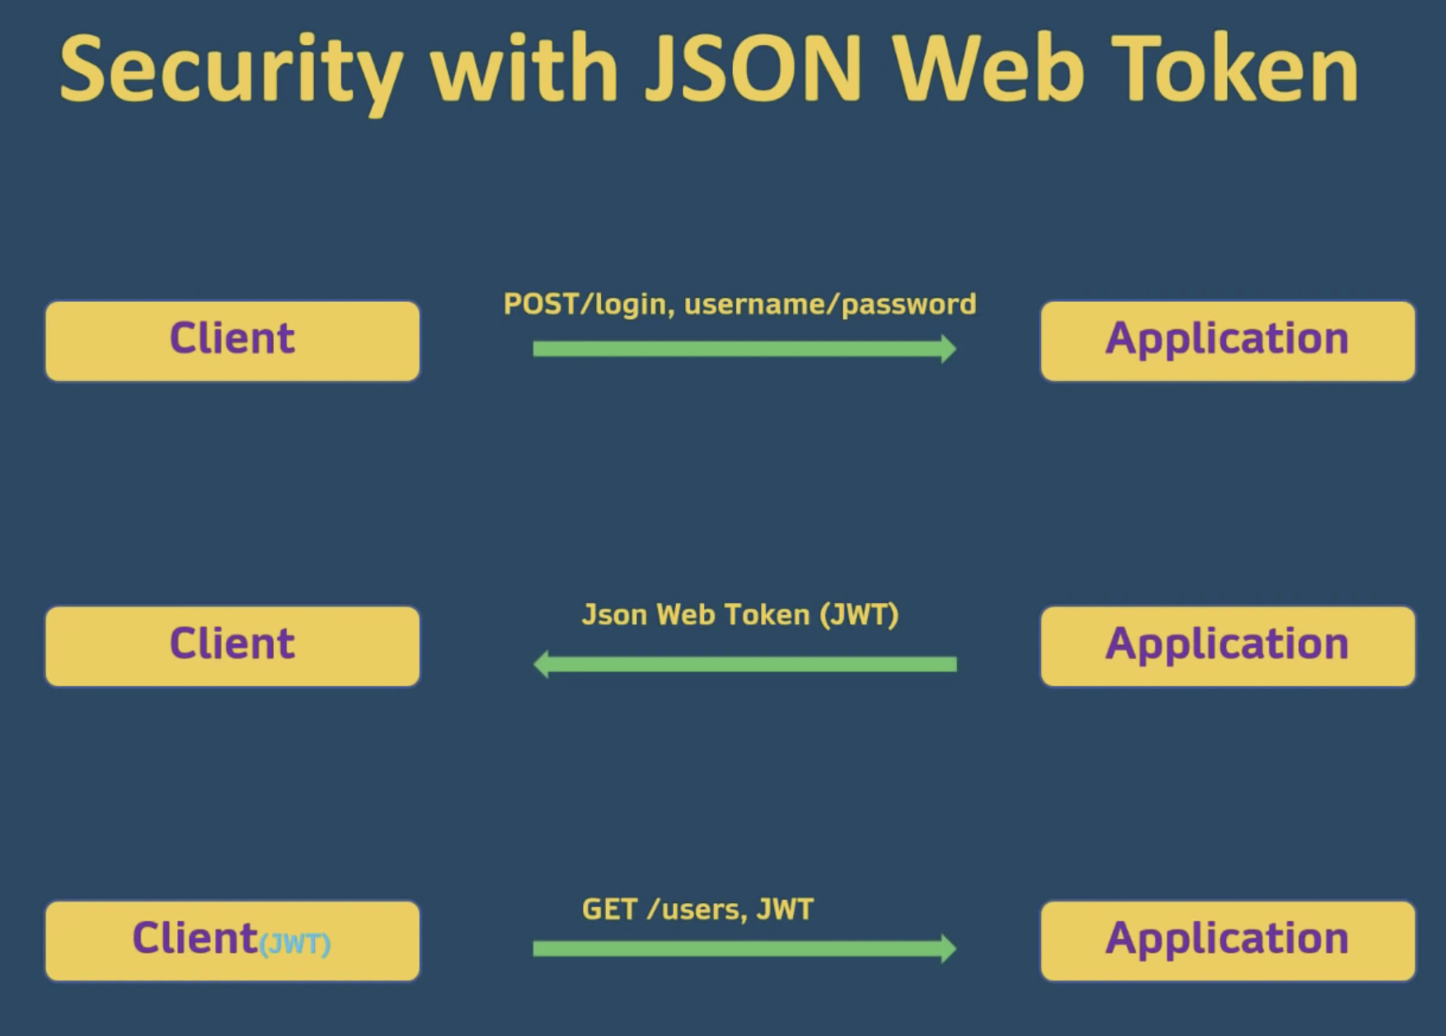
JWT Process: Server creates the token, takes user info, and digitally sign the token.

Slide 25

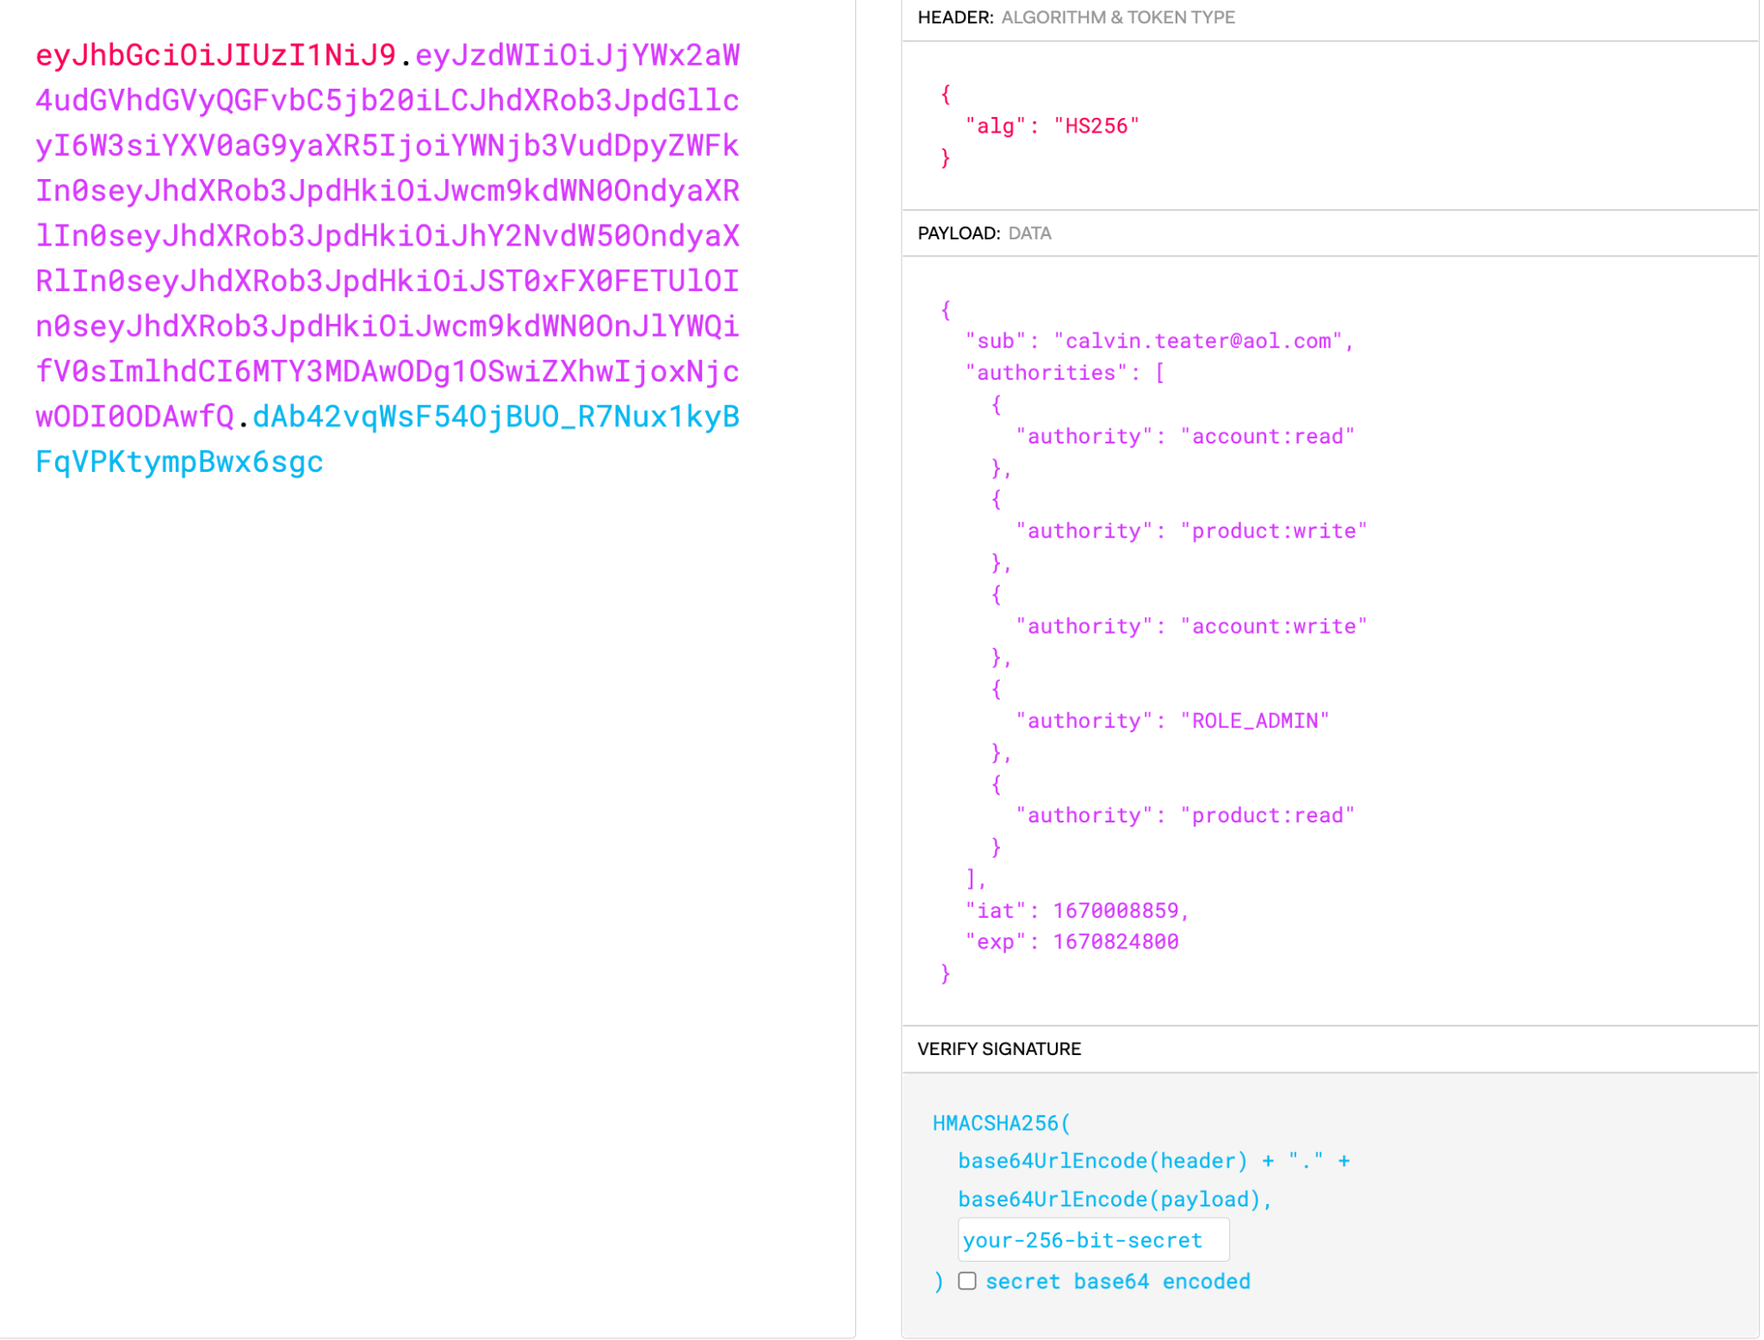
JWT Token with Roles & Permissions
Three parts of JWT:
Header ~ algorithm being used
Payload ~ contains info about the user & their authorities
Signature ~ takes encoded header & payload, use a secret with the algorithm, and sign the token

Slide 26

Test Cases
Used Postman for API testing
Test Case | Expected Results
Login (valid) | Page will accept username and password from fields. Check with database to ensure correct. Server sends JWT Token to Client in Authorization header. Transfer user to home page.
Login (invalid) | Page will not accept username or password as valid. Will transfer user back to login page for another attempt.
Register (valid) | Page will accept form data and send information to the backend. The backend will save the user into the database and return a successful response. Transfer user to login page.
Fetch Products (GET) | When page is accessed, the products will be displayed on the Frontend from the AJAX GET request made to the backend.

Slide 27
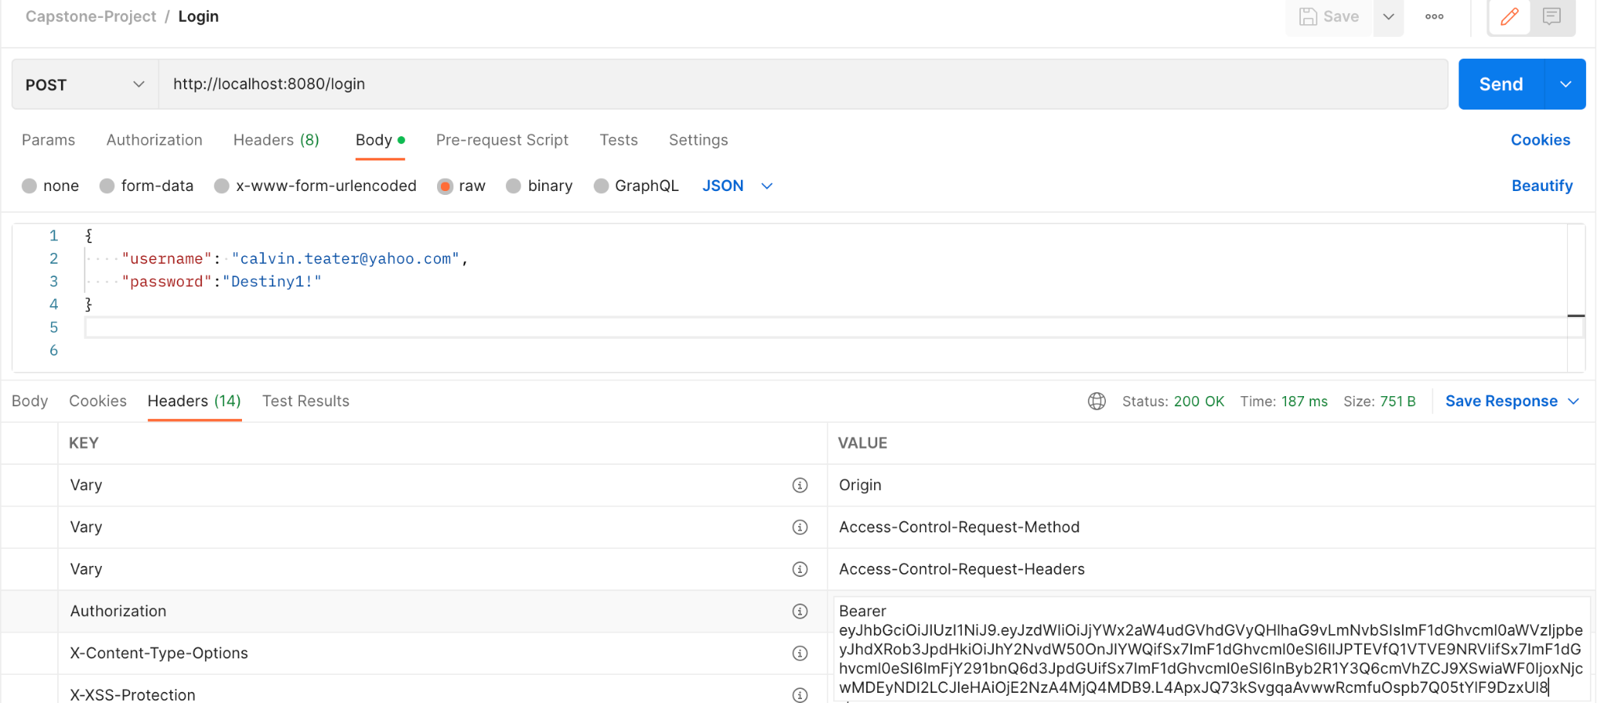
Successful Login Test Case

Slide 28
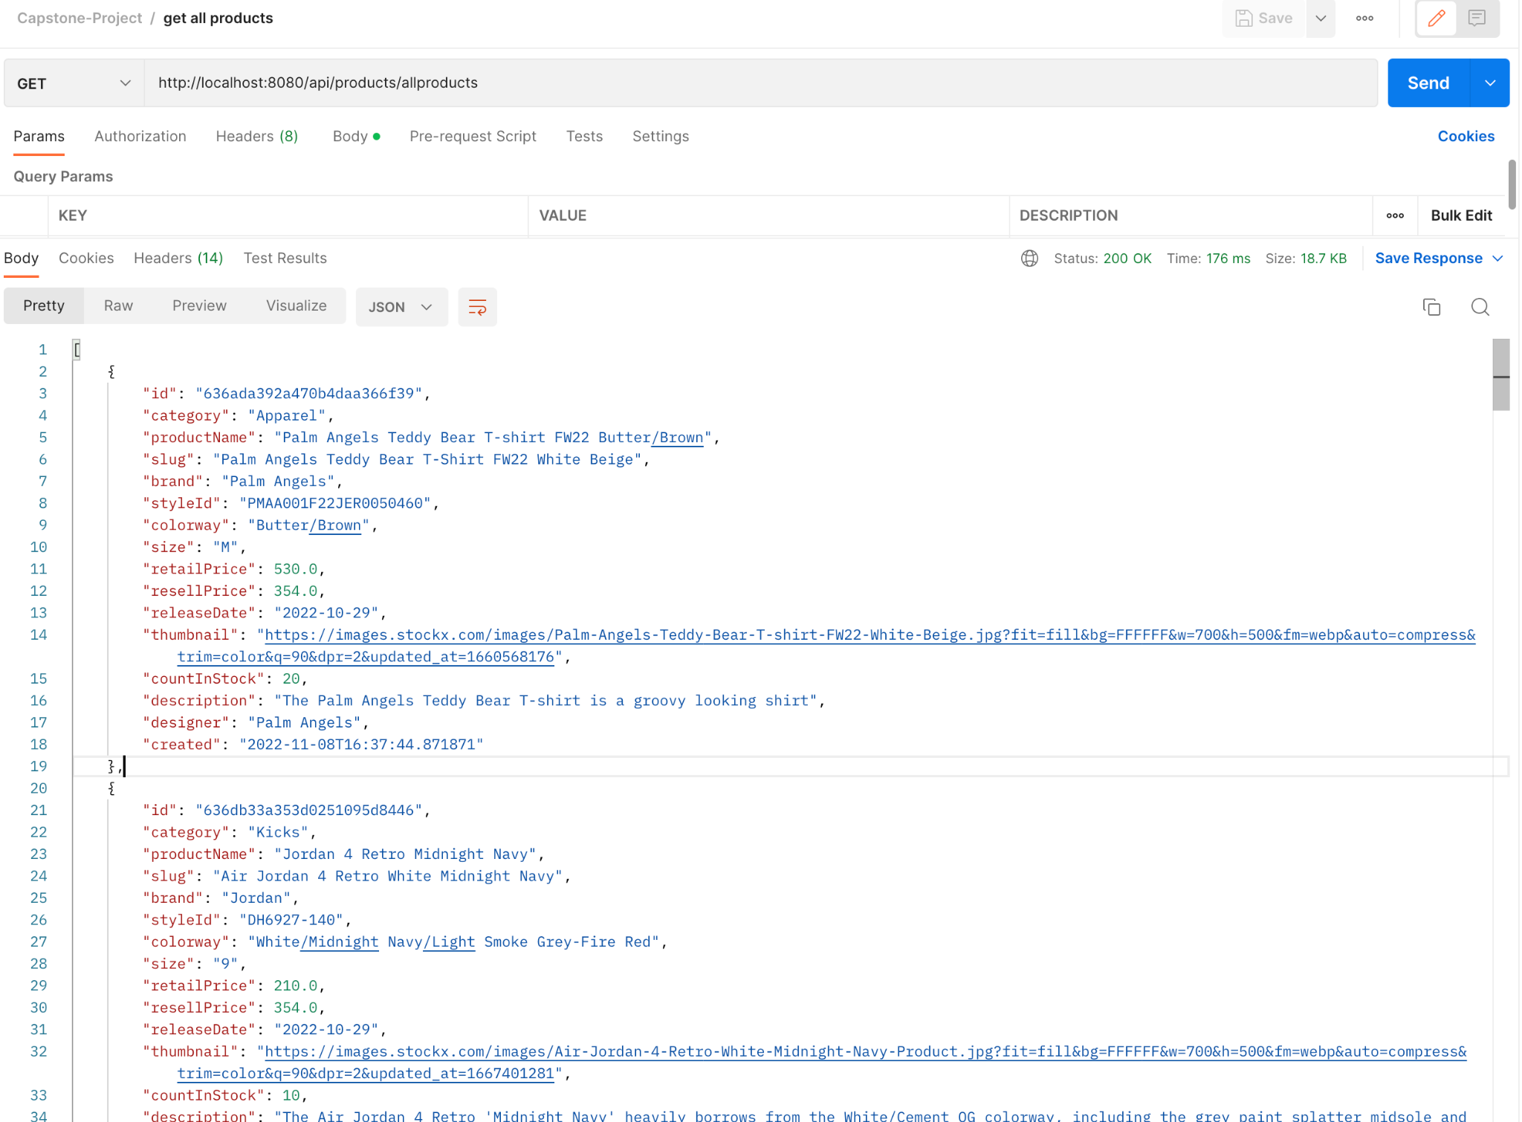
Fetch Products Test Case

Slide 29

Demo

Slide 30
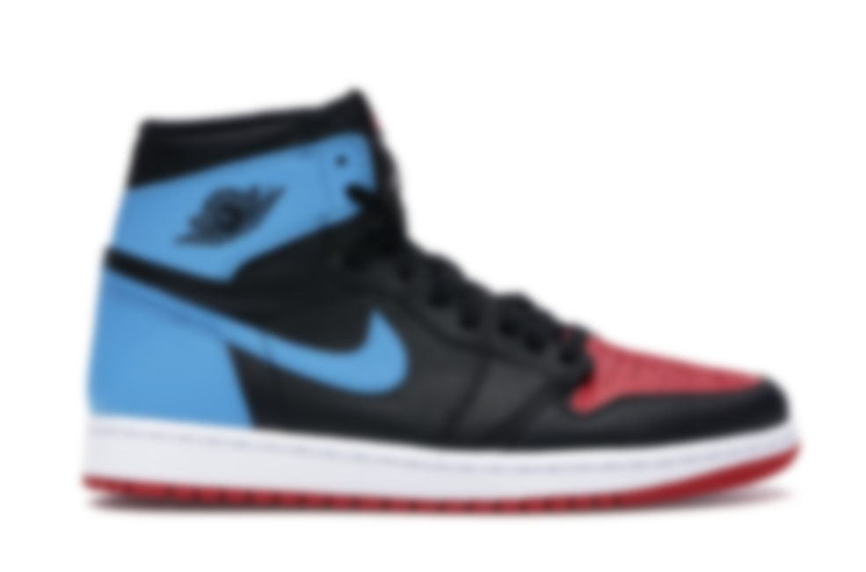
Future Work & Project Reflection
Roles:
Calvin ~ Backend Developer
Je’Shon ~ Frontend Developer
Evaluation:
Daily tasks of a software engineer is challenging at times
Our debugging skills advanced significantly
Expanded our understanding of current frameworks & technology
Planning our days & weeks at night time allowed us to be more efficient during the day
Networked with other developers & engineers on group chats
Maintained a healthy work-life balance
Future Plans:
Implementing Seller and Admin capabilities, bidding & cryptocurrency, and more
Continuing the Software Engineer roadmap so this will eventually be deployed & managed on the cloud
Making this a freelance project so we can network with potential investors

